Slide 1
Micro Services Patterns
Subramanian Murugan

Slide 2
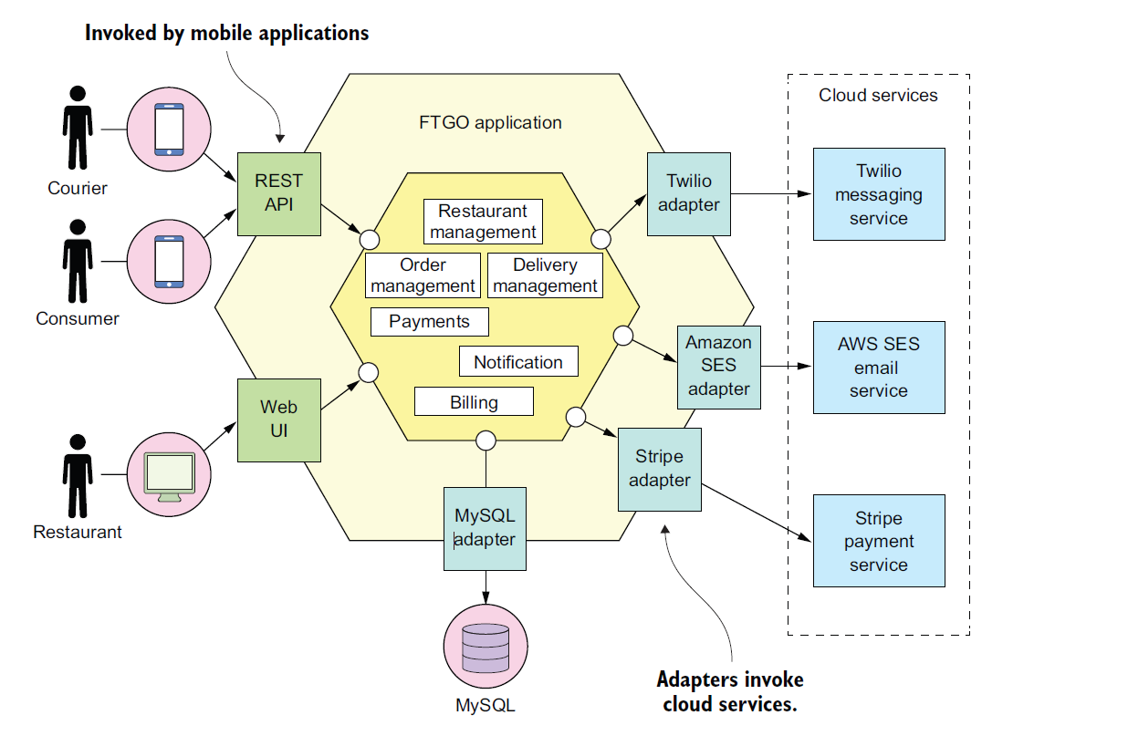

Slide 3
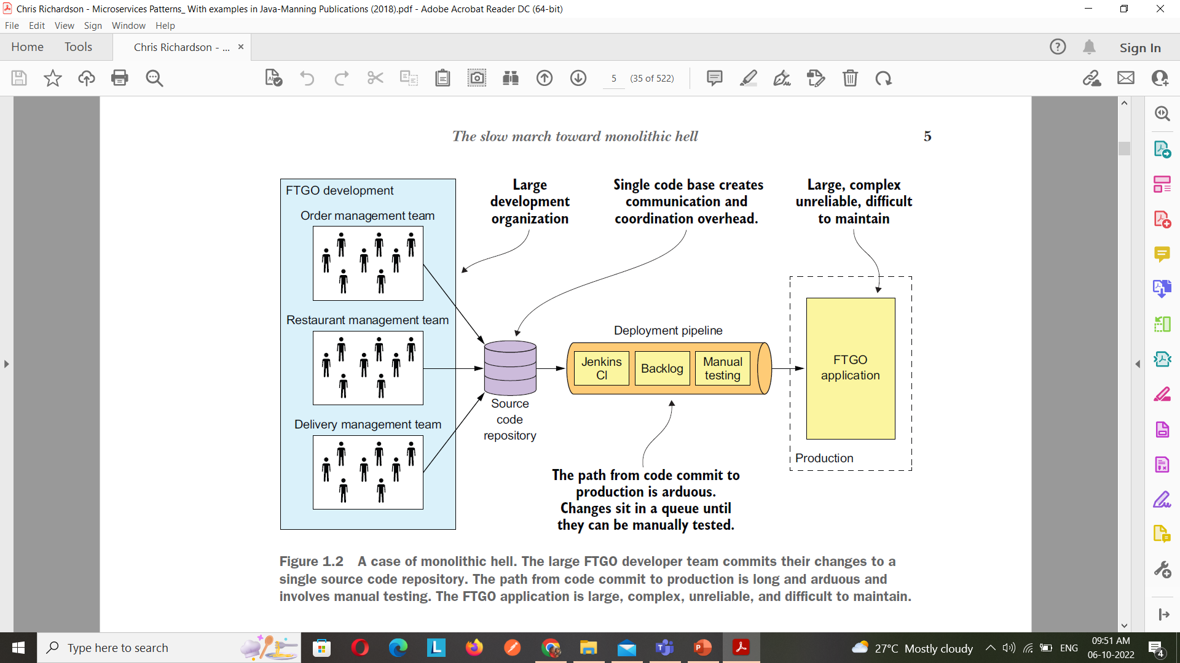

Slide 4
Application Scalability
Three-dimensional scalability model
The scale cube

Slide 5
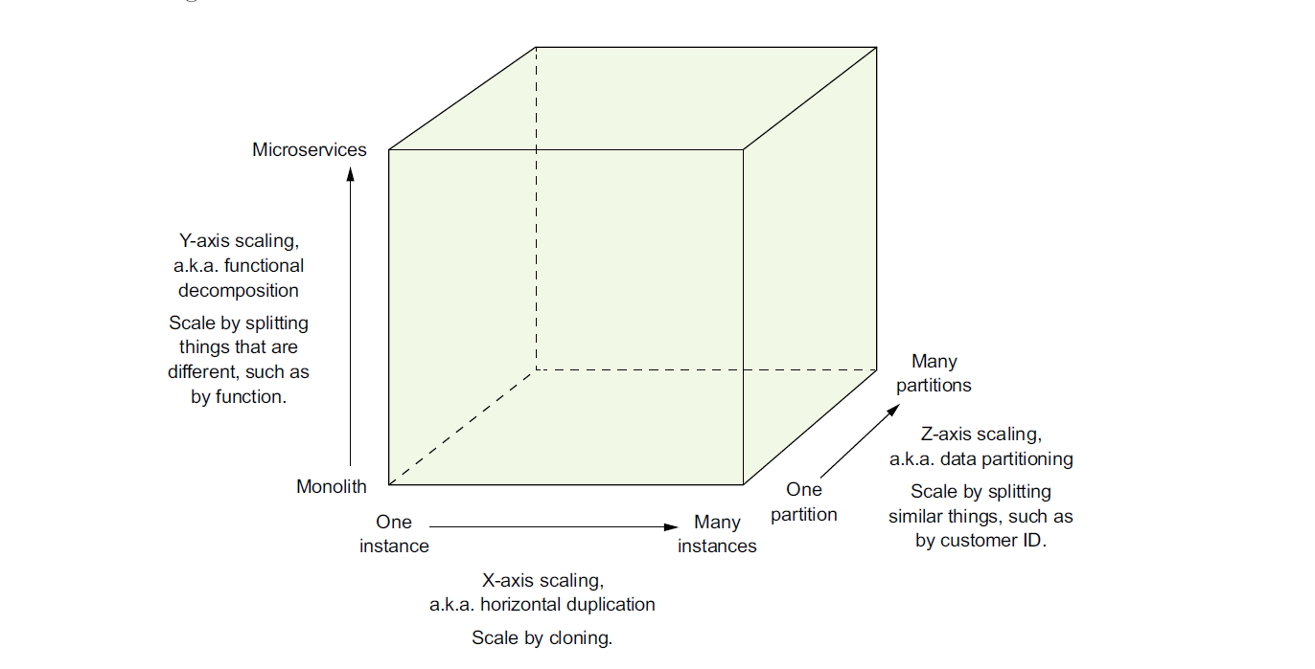

Slide 6
The Model defines three ways to scale application : X,Y,Z
X-AXIS SCALING LOAD BALANCES REQUESTS ACROSS MULTIPLE INSTANCES
X-axis scaling is a common way to scale a monolithic application
You run multiple instances of the application behind a load balancer.
The load balancer distributes requests among the N identical instances of the application.
This is a great way of improving the capacity and availability of an application.

Slide 7
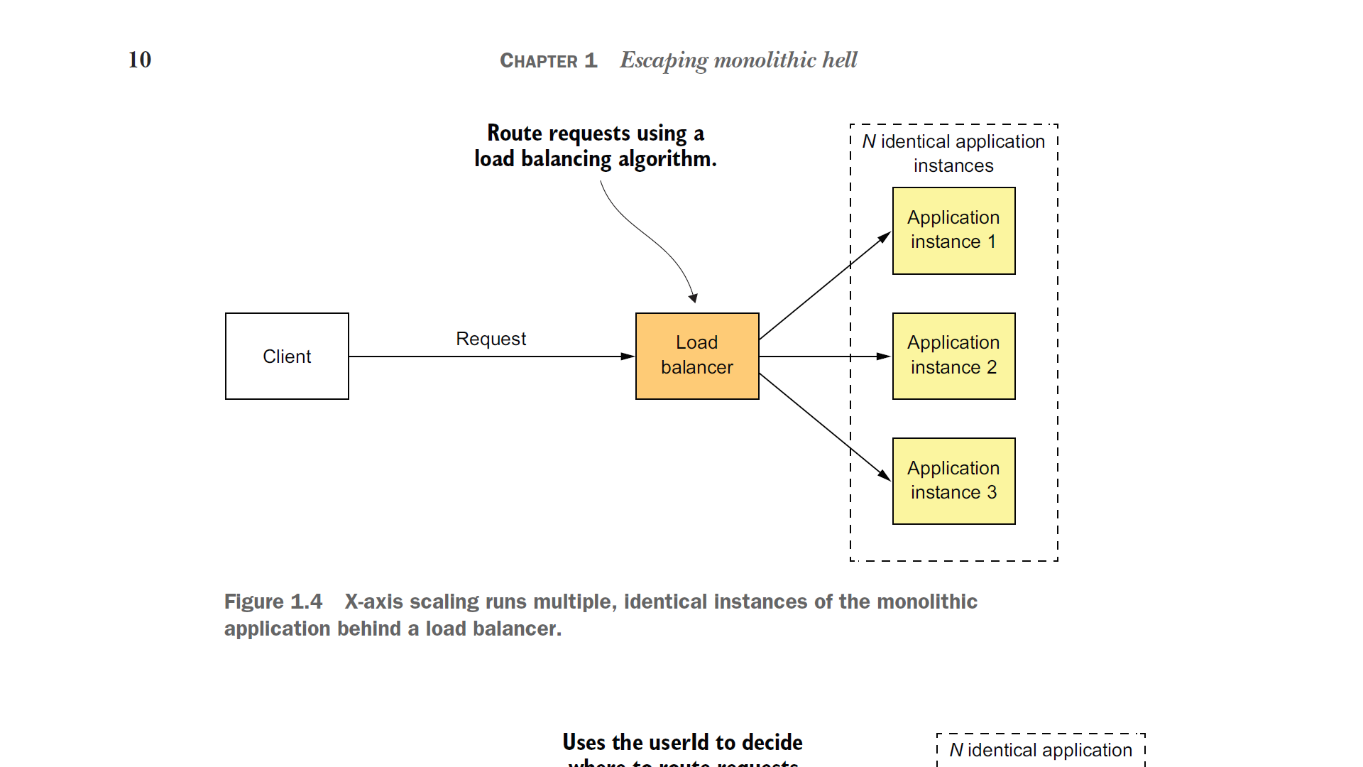

Slide 8
The Model defines three ways to scale application : X,Y,Z
Z-AXIS SCALING ROUTES REQUESTS BASED ON AN ATTRIBUTE OF THE REQUEST
Z-axis scaling also runs multiple instances of the monolith application, but unlike X-axis scaling, each instance is responsible for only a subset of the data.
The router in front of the instances uses a request attribute to route it to the appropriate instance. An application might, for example, route requests using userId.

Slide 9
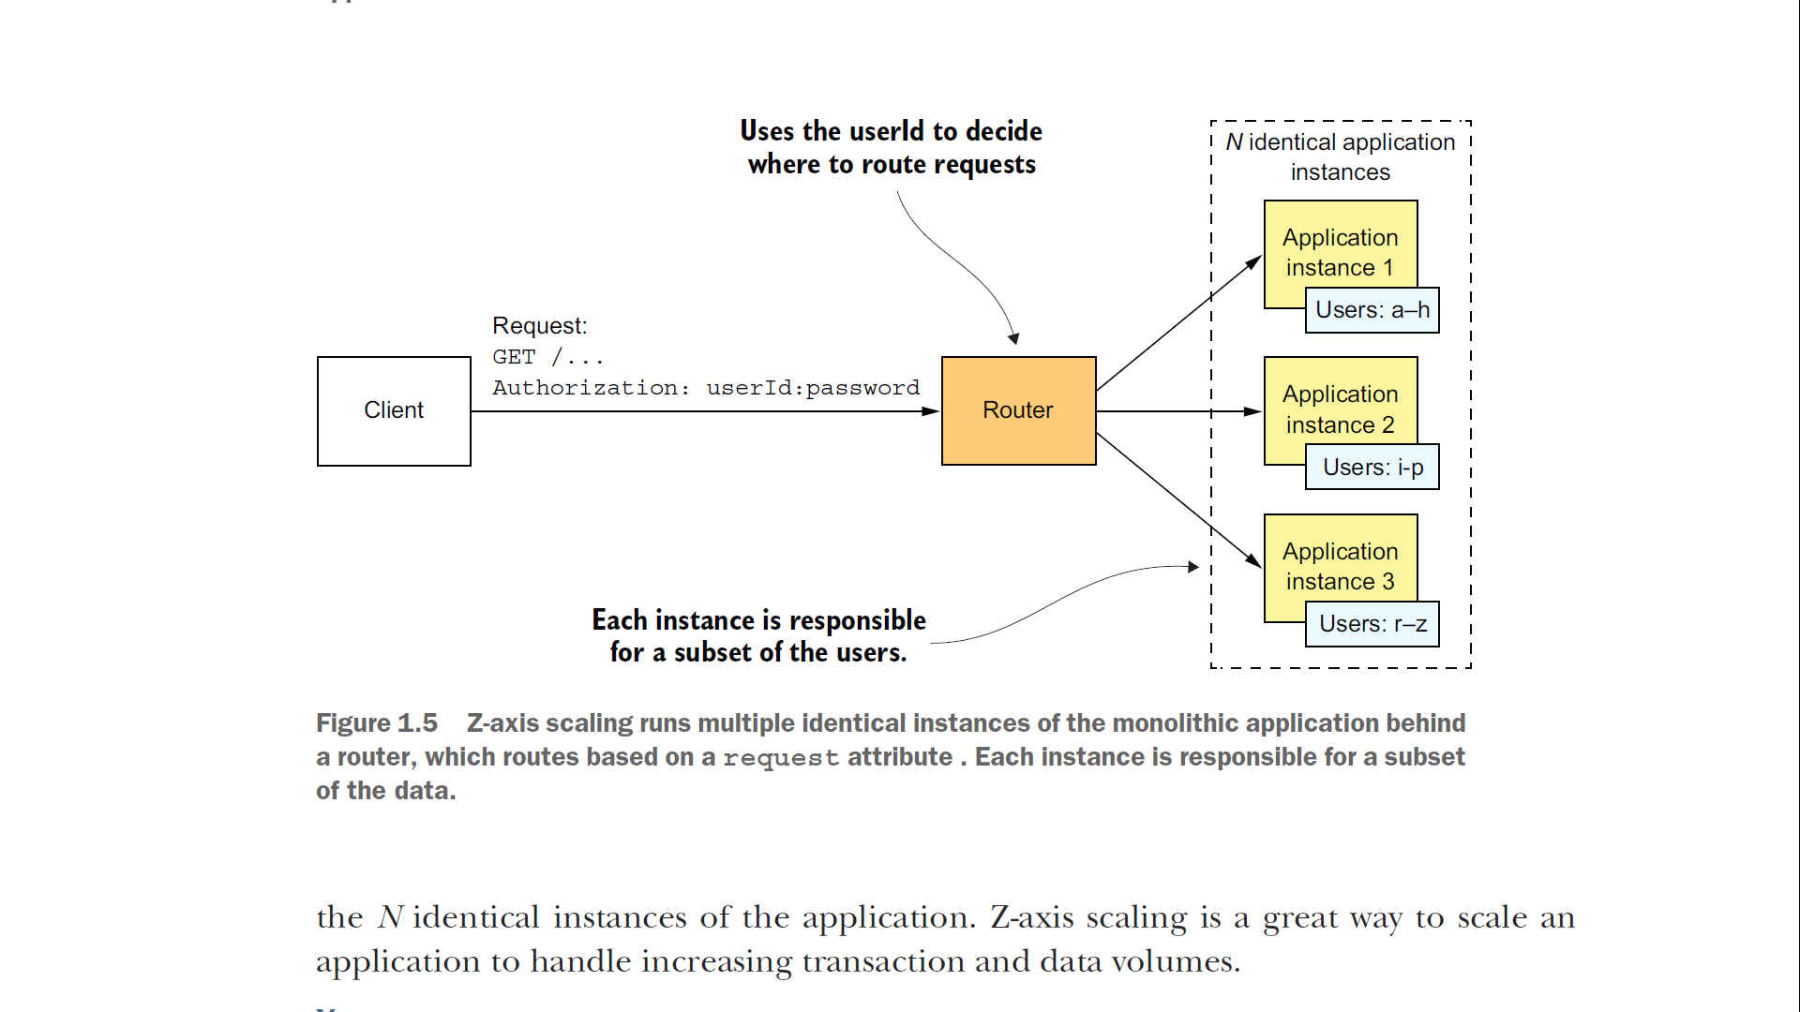

Slide 10
The Model defines three ways to scale application : X,Y,Z
Y-AXIS SCALING FUNCTIONALLY DECOMPOSES AN APPLICATION INTO SERVICES
X- and Z-axis scaling improve the application’s capacity and availability
Neither approach solves the problem of increasing development and application complexity
To solve those, you need to apply Y-axis scaling, or functional decomposition

Slide 11
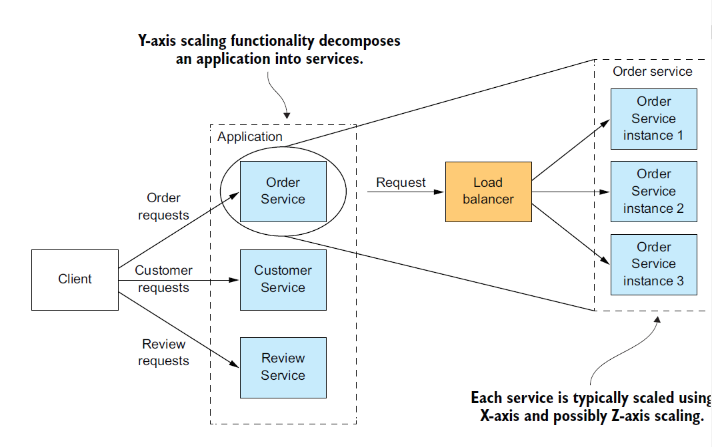

Slide 12
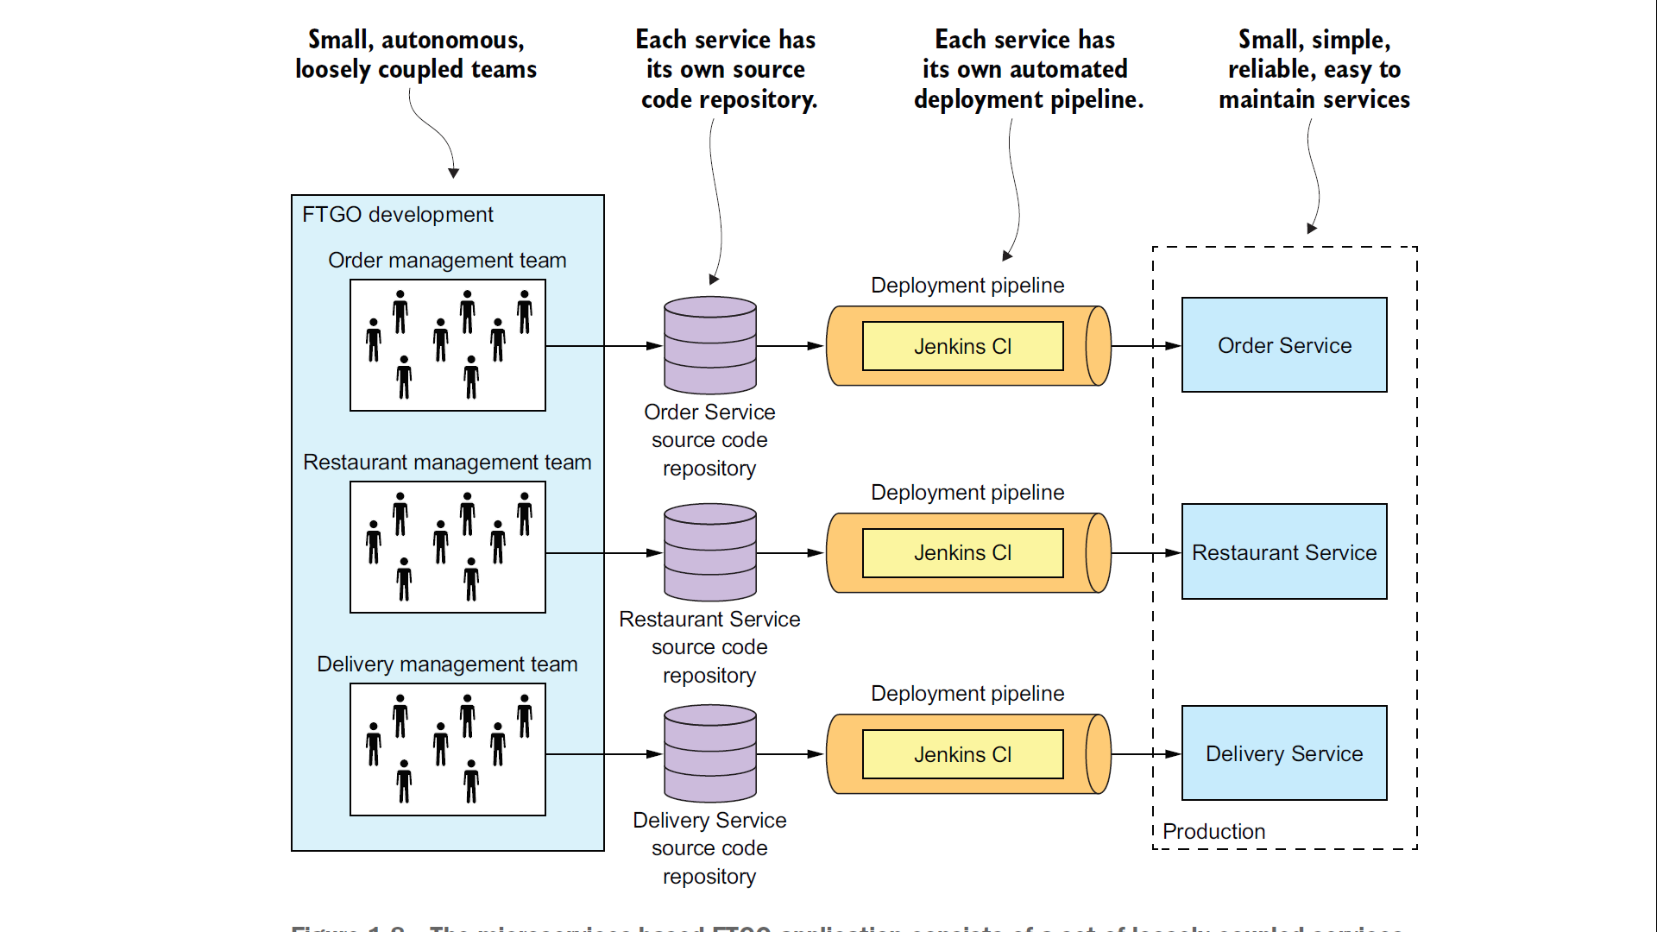

Slide 13
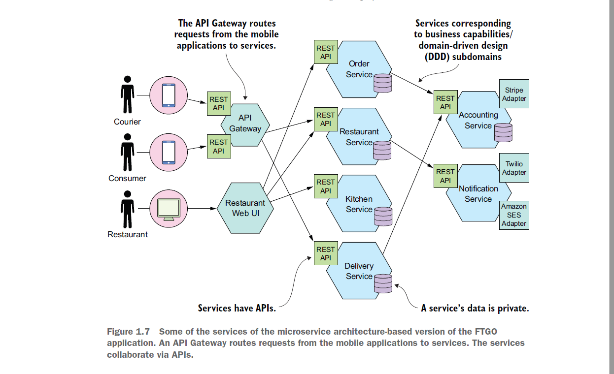

Slide 14
Micro services Pattern Language
A pattern is a reusable solution to a problem that occurs in a particular context
A software pattern solves a software architecture or design problem by defining a set of collaborating software elements.

Slide 15
Applying the microservice architecture pattern language
The microservice architecture pattern language consists of numerous groups of patterns.
The value of a pattern language exceeds the sum of it’s individual patterns because it defines these relationships between the patterns

Slide 16
Relationships among the Patterns
Predecessor – a predecessor pattern is a pattern that motivates the need for this pattern. For example, the Microservice Architecture pattern is the predecessor to the rest of the patterns in the pattern language except the monolithic architecture pattern

Slide 17
Relationships among the Patterns
Successor – a pattern that solves an issue that is introduced by this pattern.
For example, if you apply the Microservice Architecture pattern you must then apply numerous successor patterns including service discovery patterns and the Circuit Breaker pattern.

Slide 18
Relationships among the Patterns
Alternative – a pattern that provides an alternative solution to this pattern. For example, the Monolithic Architecture pattern and the Microservice Architecture pattern are alternative ways of architecting an application. You pick one or the other.

Slide 19
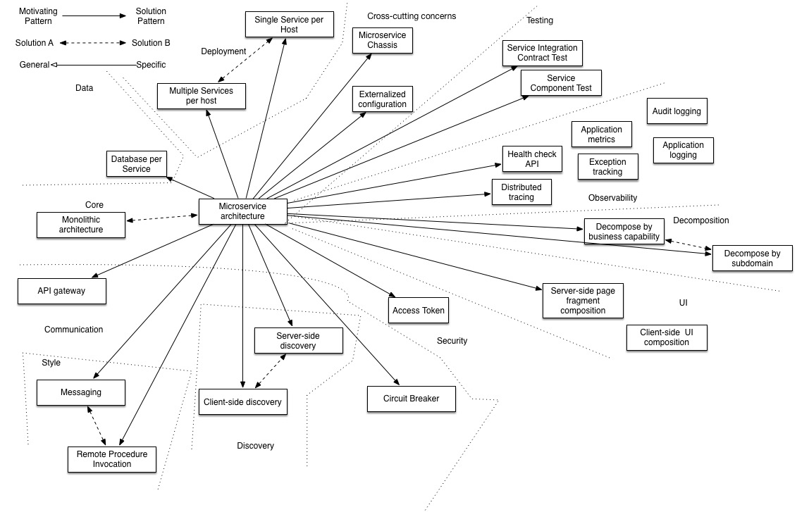

Slide 20
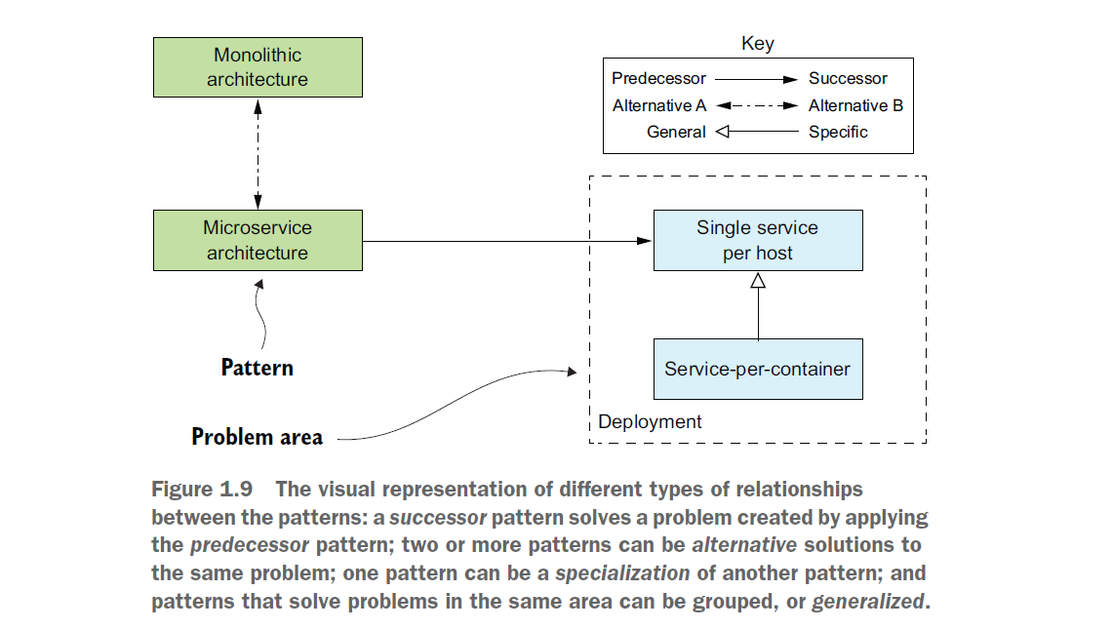

Slide 21
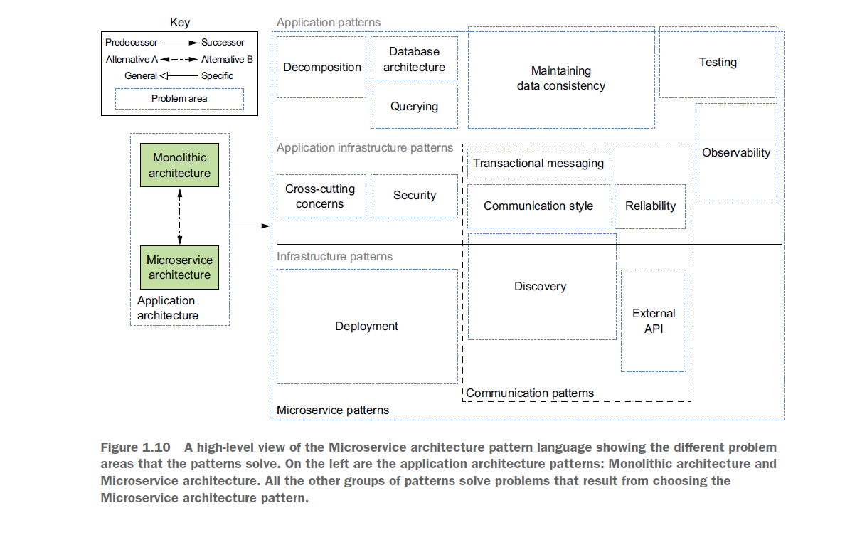

Slide 22
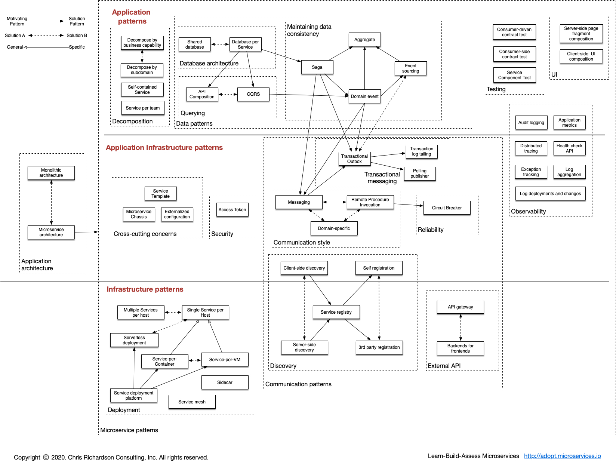

Slide 23
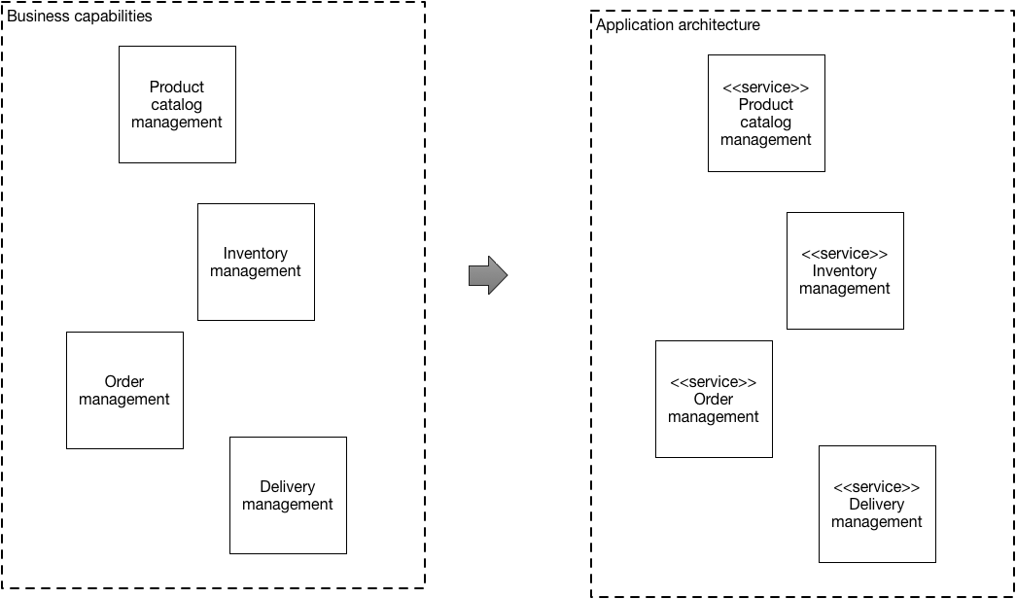

Slide 24
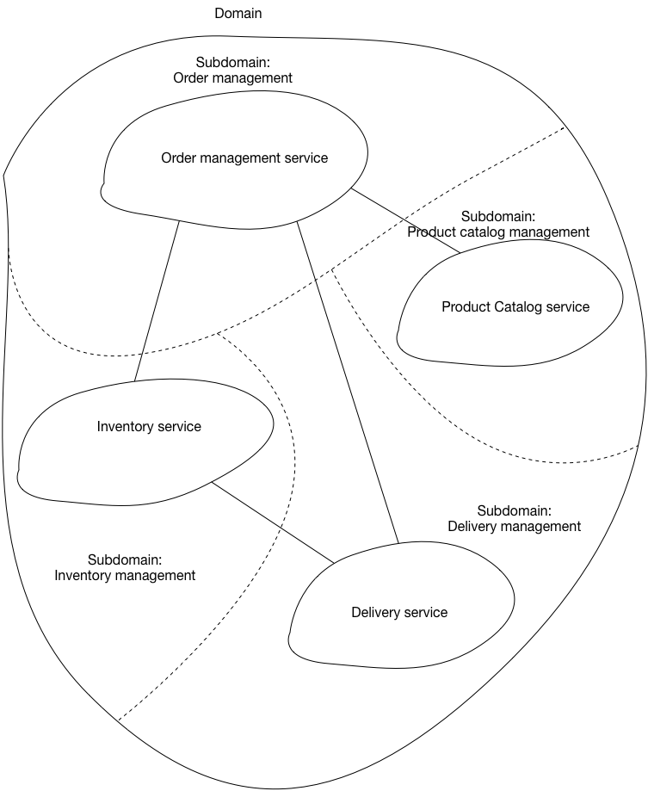
Domain Driven Design

Slide 25
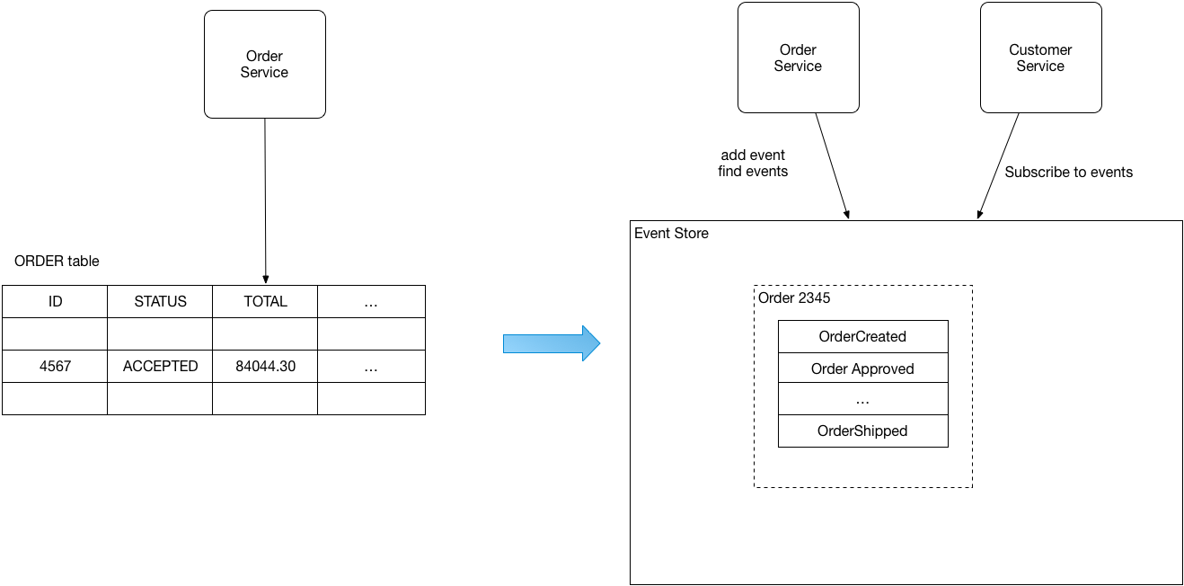
Current State of each order as a row in Orders table,
Order as a sequence of events

Slide 26
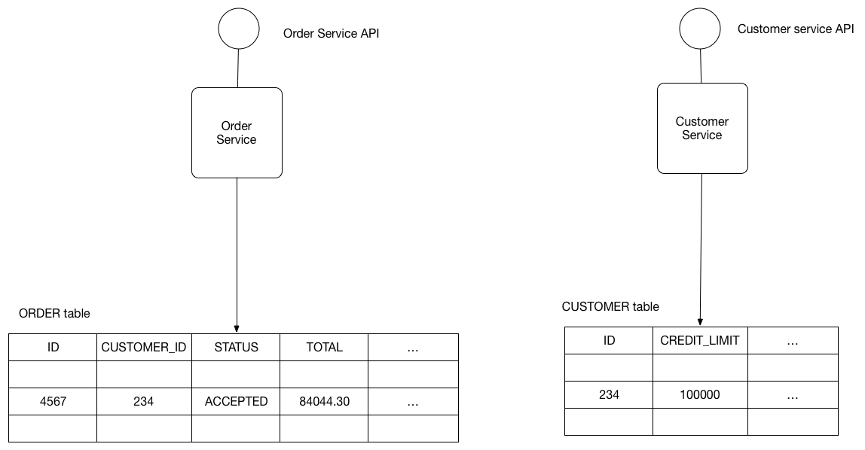
Data base Per Service

Slide 27
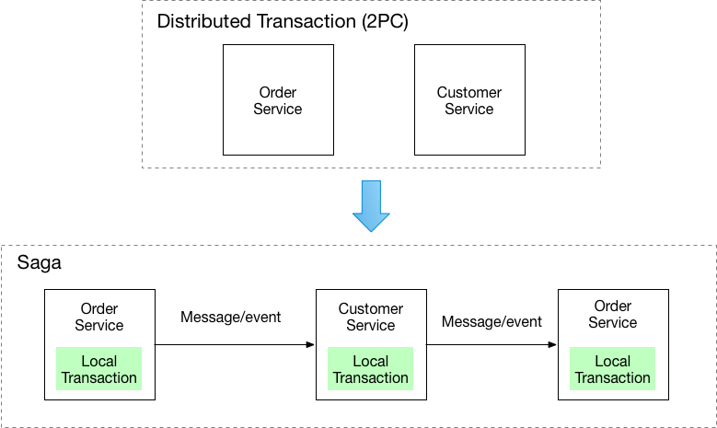
Saga Pattern

Slide 28
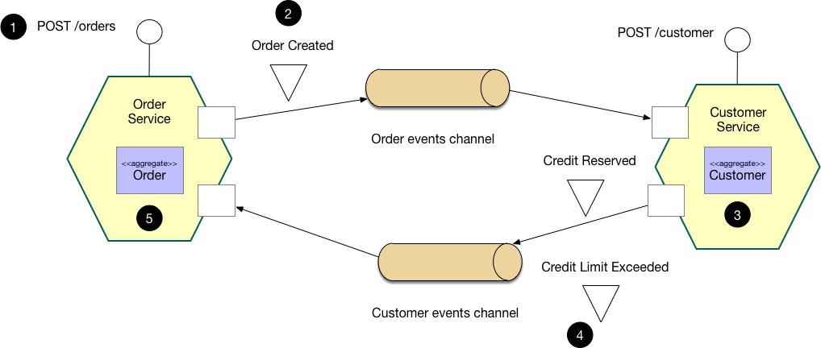

Slide 29
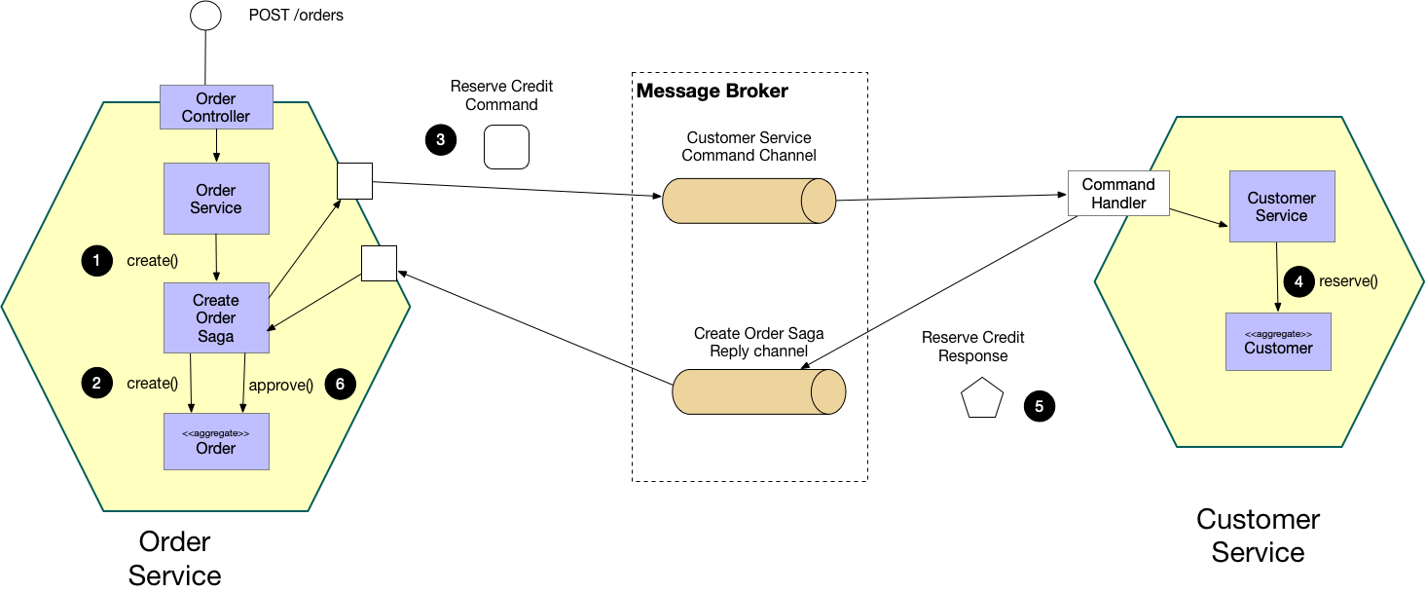

Slide 30
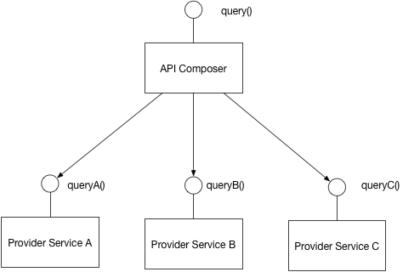
Query Retrieval – Api composer

Slide 31
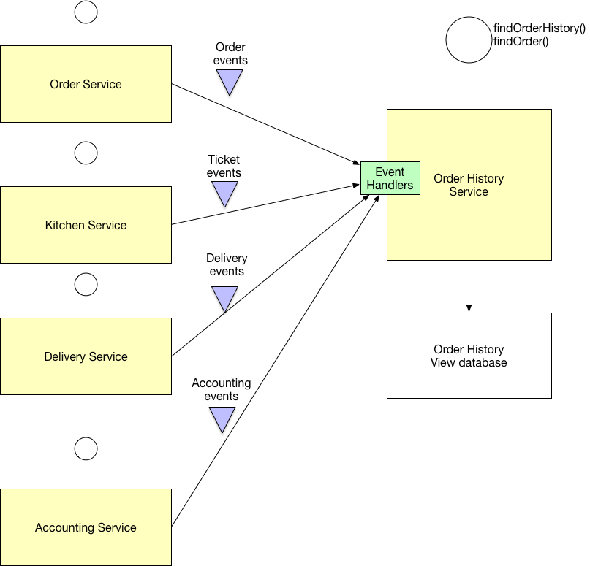
CORS

Slide 32
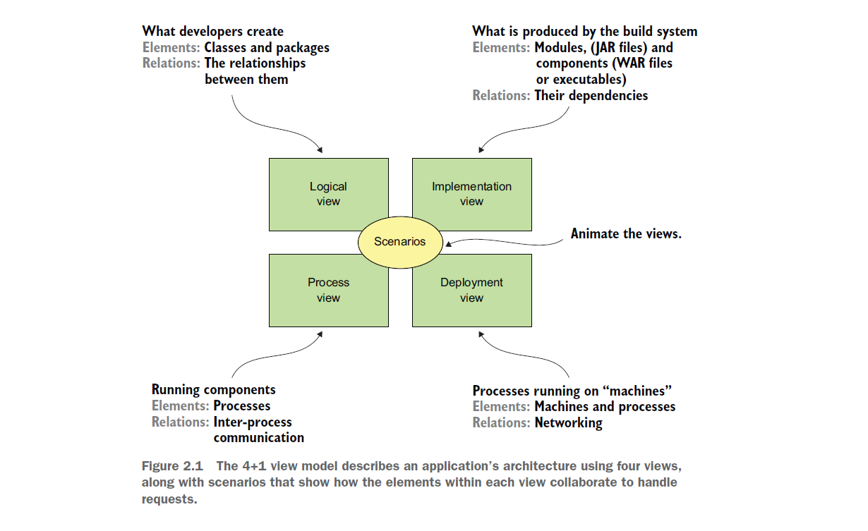
Application Architectures : 4 +1 Views

Slide 33
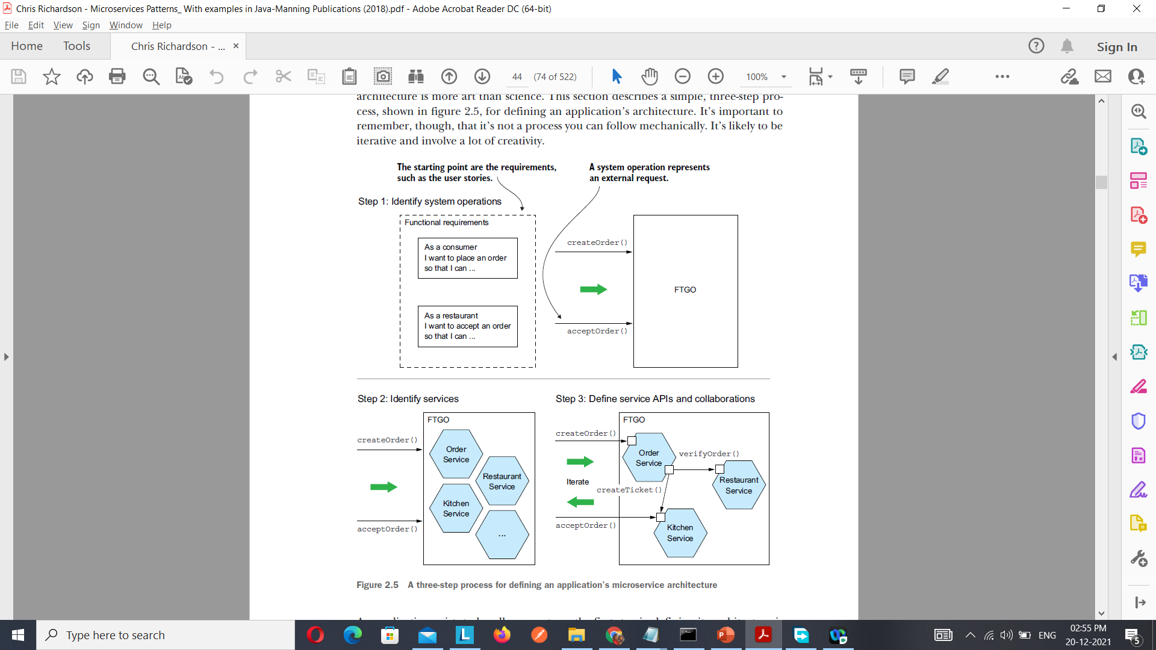

Slide 34
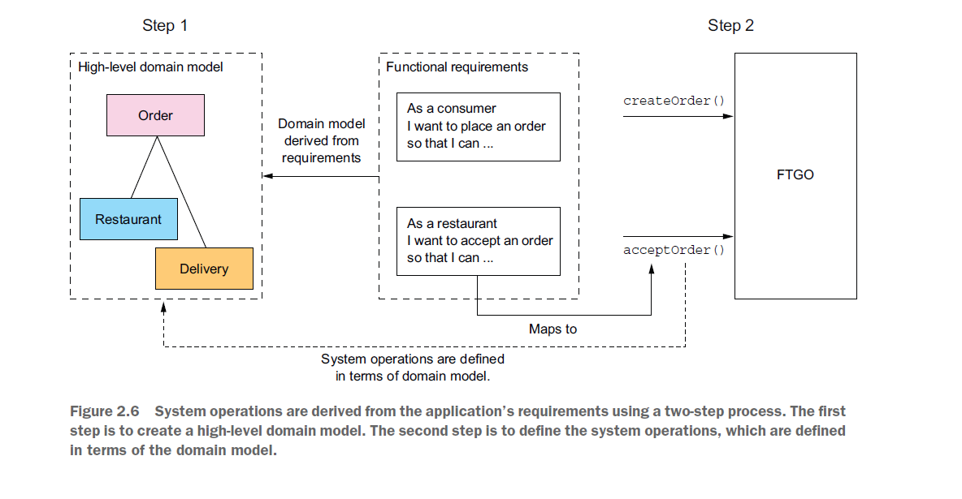

Slide 35
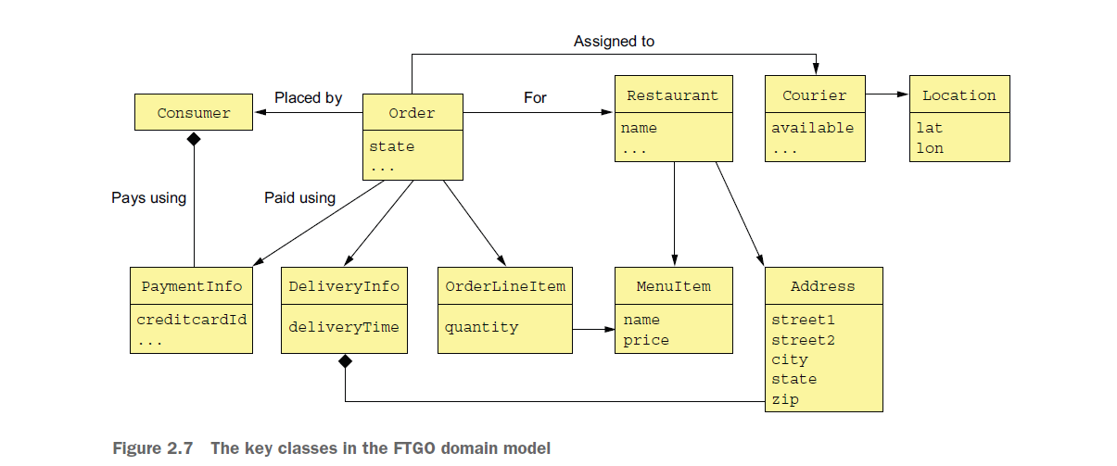

Slide 36
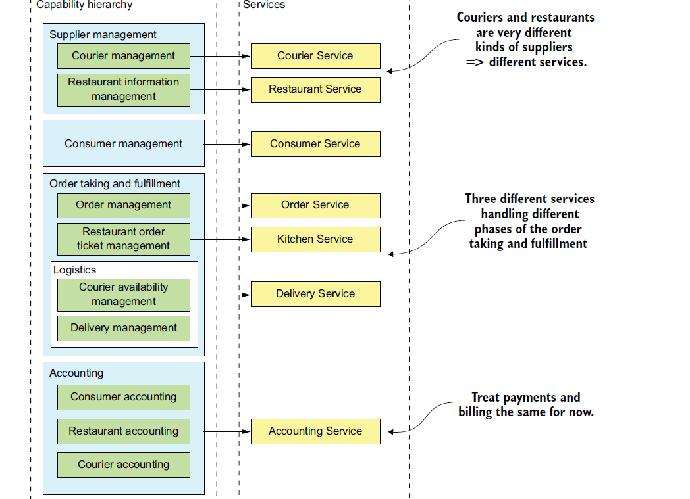

Slide 37
